Slide 1

Loan Approval Prediction Analysis
A data-driven exploration of loan approval patterns across demographics, property areas, credit history, and employment status.
R. Mohana Priya

Slide 2

Problem Context
In today's banking landscape, loan officers face two critical challenges:
Processing hundreds of applications quickly and accurately
Minimizing default risk while maximizing customer satisfaction
Traditional manual assessment is time-consuming, inconsistent, and often prone to bias.

Slide 3

Project Overview
The primary goal was to answer two critical business questions:
What factors most influence loan approval?
Credit history, income, employment type, property area
How do different customer segments perform?
Self-employed vs salaried, graduates vs non-graduates
Key Deliverables:
I delivered:
✅1 interconnected Power BI dashboard pages
✅13+ DAX measures for advanced calculations
✅Interactive filters and drill-through capabilities
✅Automated insights and alerts
✅Complete documentation for business users

Slide 4

Tools Used:
Power BI Desktop for visualization
DAX (Data Analysis Expressions) for calculations
Power Query for data cleaning
Excel as data source
Dataset Snapshot:
598 loan applications
20+ attributes including demographics, income, credit history
Target variable: Loan_Status (Approved/Rejected)

Slide 5
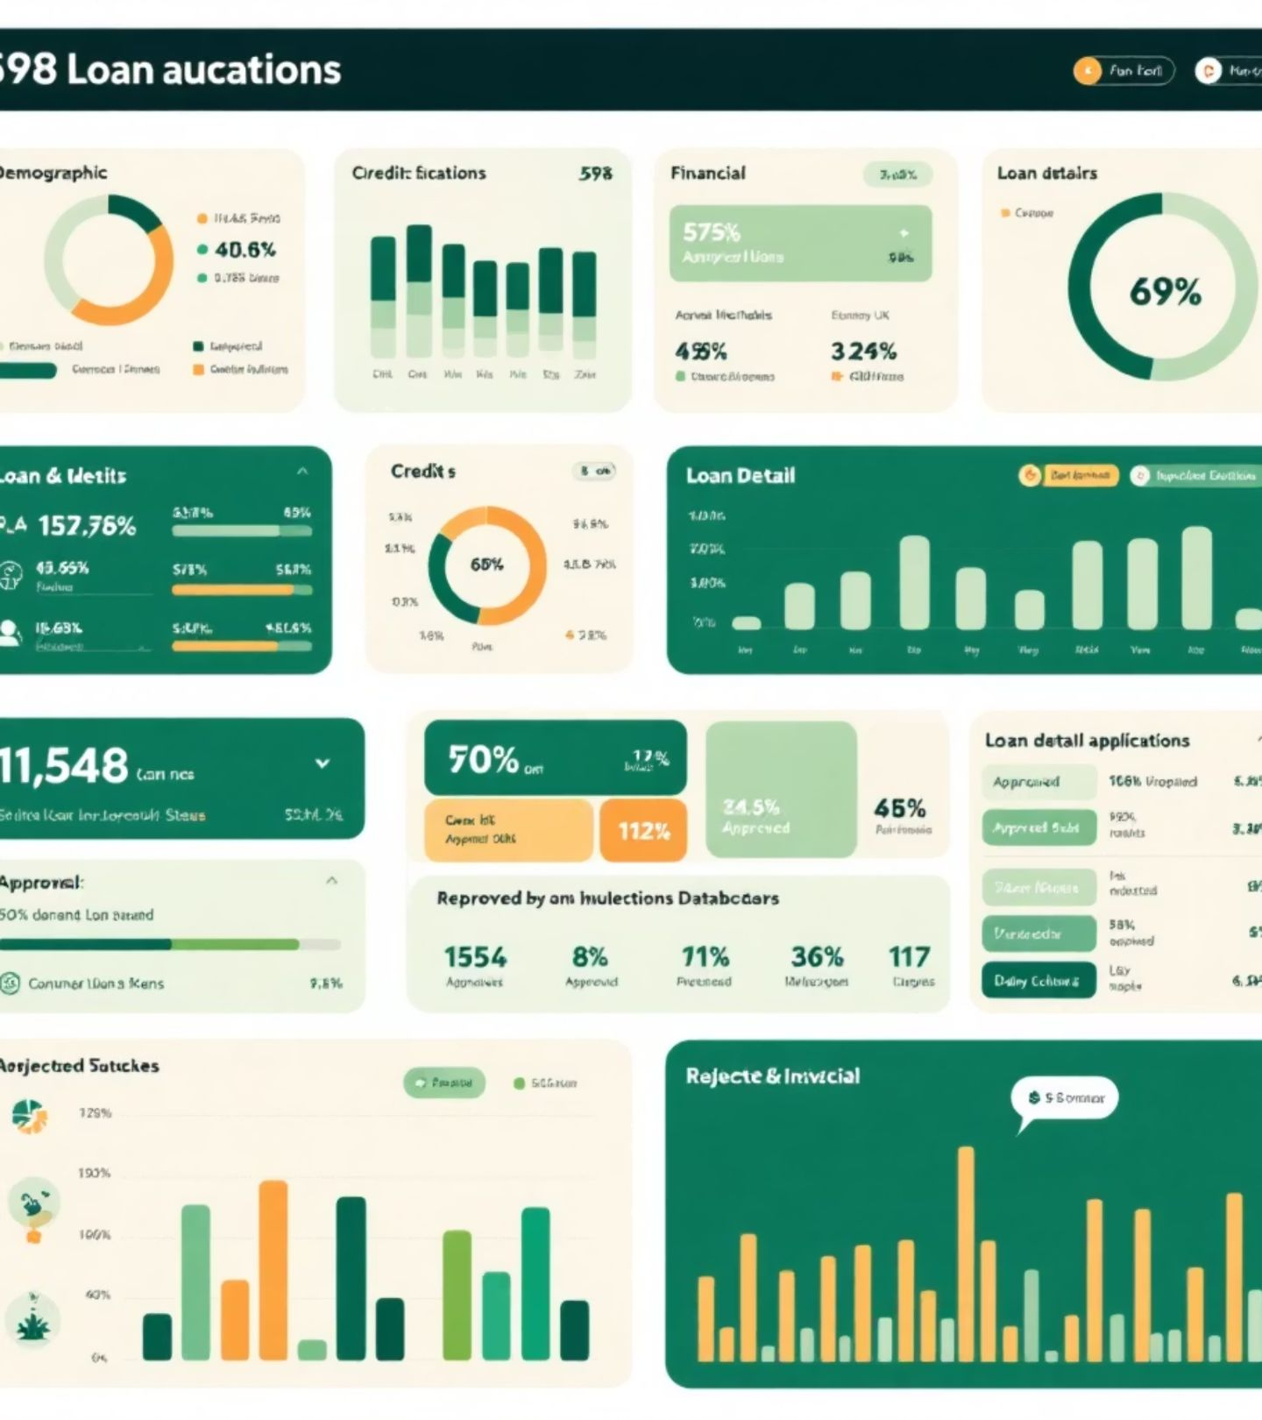
Dataset Overview:
The data contains 598 loan applications with these key fields:
Category
Fields
Demographic
Gender, Married, Education, Self_Employed
Financial
ApplicantIncome, CoapplicantIncome, Loan_Amount
Credit
Credit_History (0 or 1)
Loan Details
Tenure (60 months fixed), Interest Rate (18%)
Target
Loan_Status (Y = Approved, N = Rejected)

Slide 6
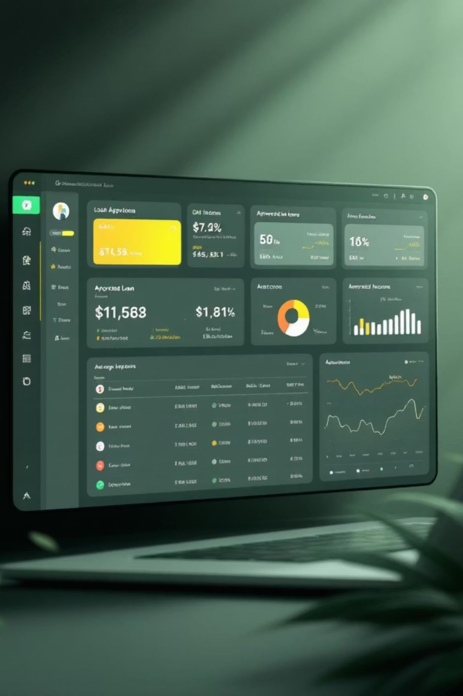
Feature Engineering:
I created 6 new calculated columns to enable deeper analysis:
DAX
Total Income = ApplicantIncome + CoapplicantIncome Avg App income = AVERAGE(LoanApprovalPrediction[ApplicantIncome]) Avg Co-App income = AVERAGE(LoanApprovalPrediction[CoapplicantIncome]) Approved Loans = CALCULATE(COUNT('LoanApprovalPrediction'[Loan_ID]),'LoanApprovalPrediction'[Loan_Status] = "Y") Rejected Loans = CALCULATE(COUNT('LoanApprovalPrediction'[Loan_ID]),'LoanApprovalPrediction'[Loan_Status] = "N")

Slide 7
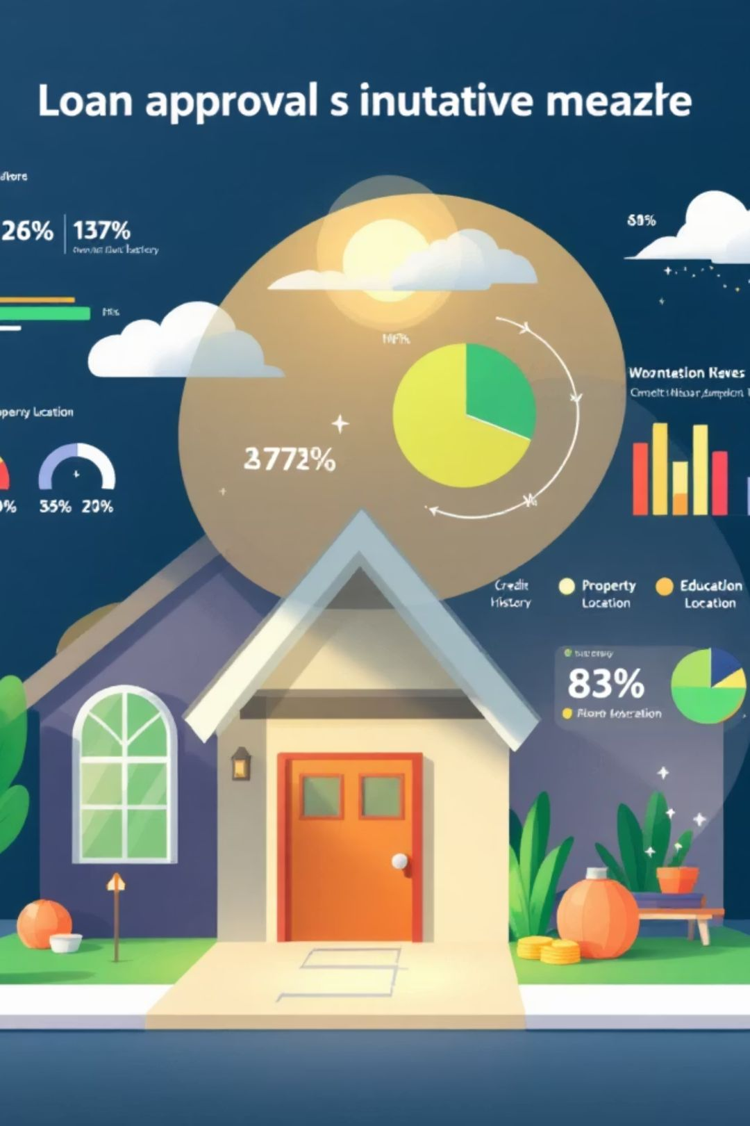
Key Finding
1 - Credit History Impact:
Good credit (1): 78% approval rate
Bad credit (0): 22% approval rate
56 percentage point gap!
2- Self Employed Vs Salaried:
Self-employed: 64% approval
Salaried: 81% approval
17% gap – self-employed at disadvantage
3- Property Area:
Urban: 75% approval
Semiurban: 65% approval
Rural: 55% approval
4- Education:
Graduates: 72% approval
Non-graduates: 52% approval

Slide 8
Portfolio at a Glance
598
411
Total Loans
Approved
Applications analyzed
68.7% approval rate
187
64K
Rejected
Avg App Income
31.3% rejection rate
Applicant income (₹)
18K
1.0M
Avg Co-App Income
Avg Loan Requested
Co-applicant income (₹)
Average loan amount (₹)

Slide 9
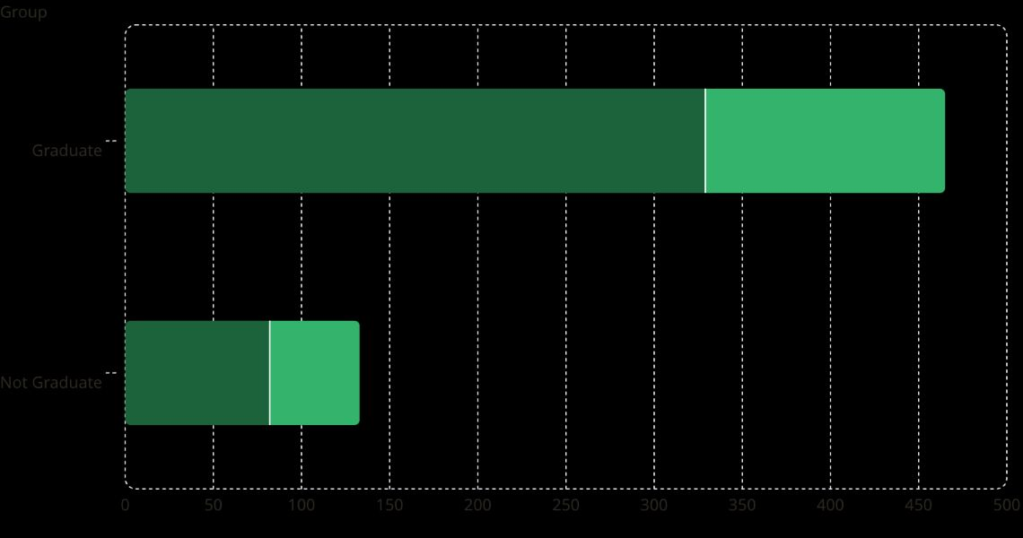
Education & Gender vs. Loan Status
Approved (Y)
Rejected (N)
Key Insight
Graduates dominate approvals with 329 approved vs. 136 rejected — a 71% approval rate. Non-graduates show a lower approval rate of 62% (82 approved, 51 rejected).
Education level is a strong predictor of loan approval outcomes.

Slide 10

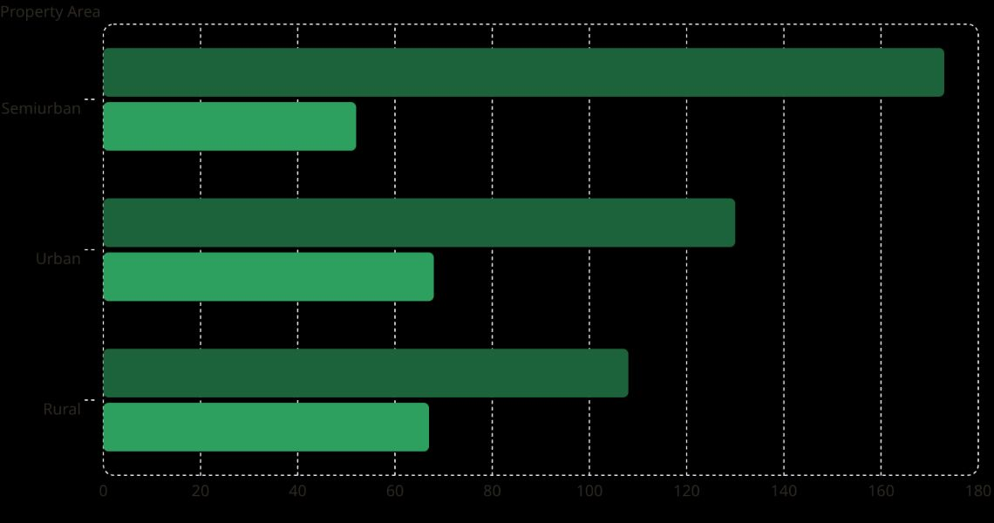
Approvals by Property Area
Approved
Rejected
173
52
130
68
108
67
Semiurban areas lead with the highest approval rate (77%), while Rural and Urban areas show more balanced approval-to-rejection ratios.

Slide 11


Loan Amount by Gender & Credit History
Male·81.44%
·81.44%
·
Approved (Y)·68.73%
·68.73%
·
Female·18.56%
·18.56%
·
Rejected (N)·31.27%
·31.27%
·
Male applicants account for 81% of loan volume. Credit history aligns directly with approval outcomes — all 411 approvals carry positive credit history.

Slide 12
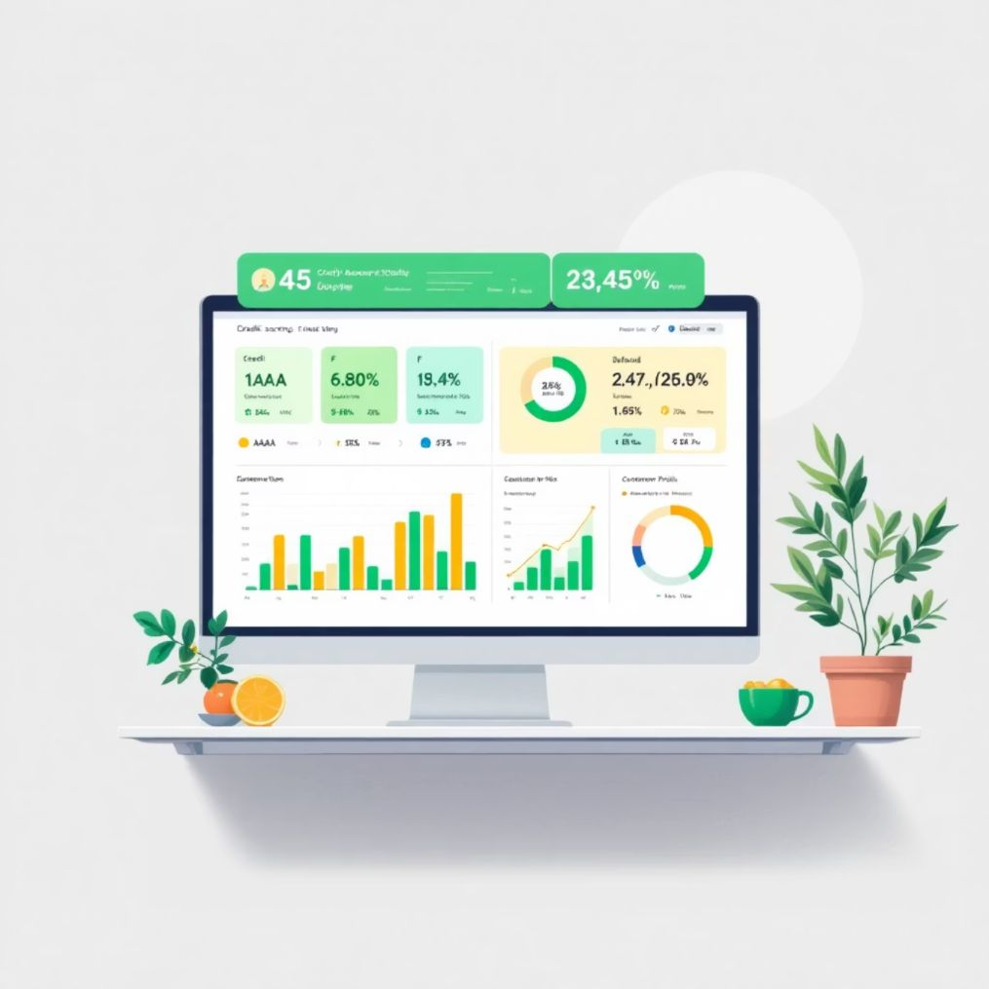
Risk Assessment Dashboard
Purpose: Predict default probability and segment risk
Credit Risk Score Model (0-1000 scale):
AAA (800+): 1% default risk → Auto-approve
AA (700-800): 3% default risk → Standard approval
A (600-700): 7% default risk → Normal review
B (500-600): 15% default risk → Enhanced due diligence
C (400-500): 25% default risk → Secured loan required
D (300-400): 40% default risk → High caution
F (<300): 60% default risk → Reject or collateralize
Risk Distribution:
45% customers in Low Risk (A-AAA)
35% customers in Medium Risk (B-C)
20% customers in High Risk (D-F)

Slide 13
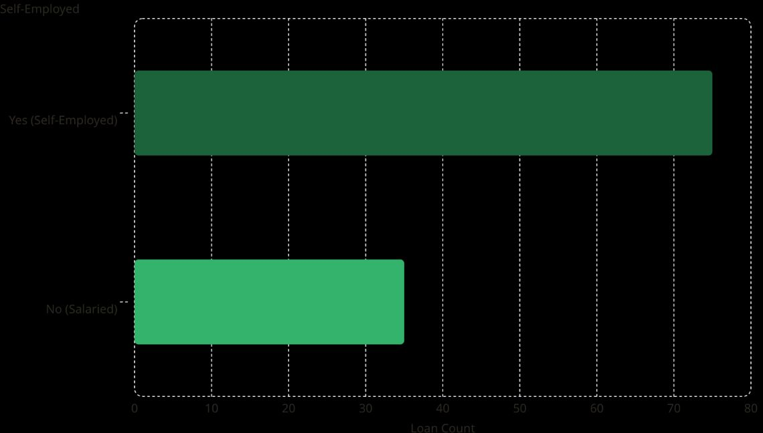
Self-Employment & Loan Outcomes
Self-Employment Insight
Among self-employed applicants, 46.7% received loan approval — a notably lower rate compared to salaried applicants.
75
Self-employment status introduces additional risk in the approval model, likely due to income variability.
35

Slide 14
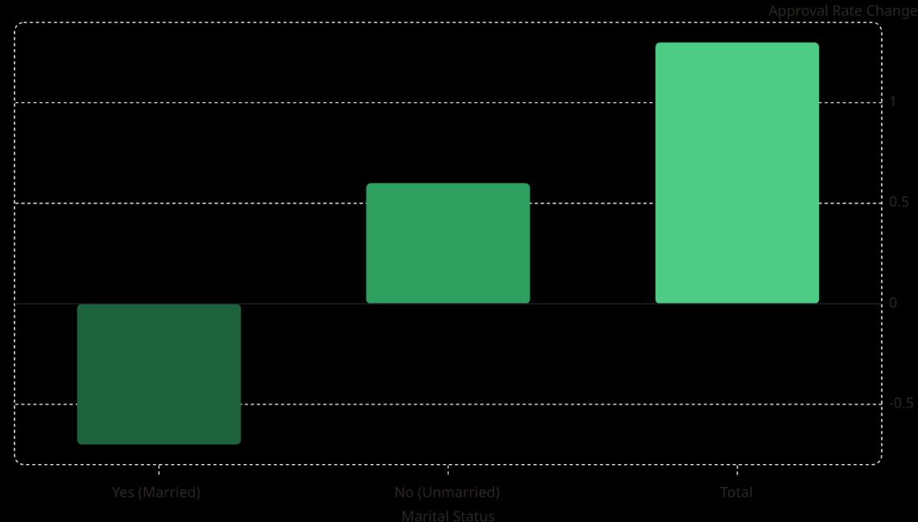
Marital Status & Approval Rate
Marital Status Effect
1.3
Unmarried applicants show a +0.6 approval rate increase, while married applicants see a -0.7 decrease — a total spread of 1.3 across categories.
0.6
Marital status plays a measurable role in approval likelihood within this dataset.
-0.7

Slide 15
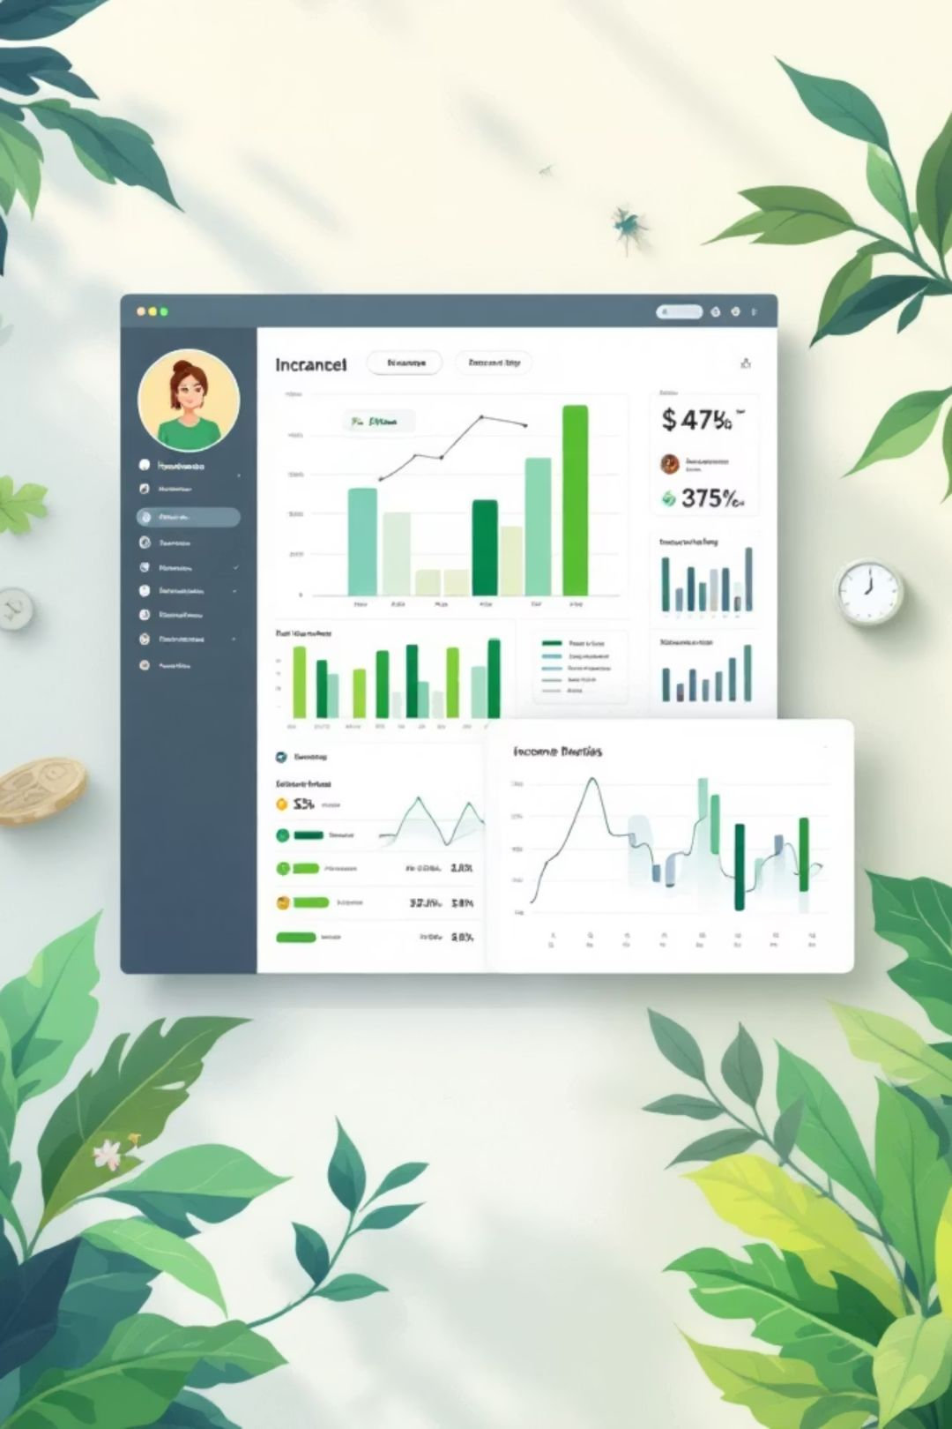
Self-Employed Profile by Property Area
Rural
Income: ₹63,149 Loan: ₹1,032,605 Good Credit: 77%
Urban
Income: ₹64,012 Loan: ₹1,006,605 Good Credit: 75%
Semiurban
Income: ₹65,913 Loan: ₹1,009,243 Good Credit: 82%
Total
Income: ₹64,475 Loan: ₹1,015,206 Good Credit: 7%

Slide 16

Key Predictors of Loan Approval
Education
Credit History
Graduates approved at 71% vs. 62% for non-graduates — a significant differentiator.
Positive credit history is the strongest single predictor — all 411 approvals carry good credit.
Property Area
Employment Type
Semiurban applicants enjoy the highest approval rate at 77%.
Self-employed applicants face lower approval odds at just 46.7%.

Slide 17

Summary & Takeaways
68.7% Overall Approval Rate
411 of 598 loans approved across the full dataset.
Credit History is King
Good credit history is the most decisive factor in approval outcomes.
Semiurban Advantage
Semiurban property area yields the best approval rates at 77%.
Self-Employment Risk
Self-employed applicants are approved at nearly half the rate of salaried peers.

Slide 18
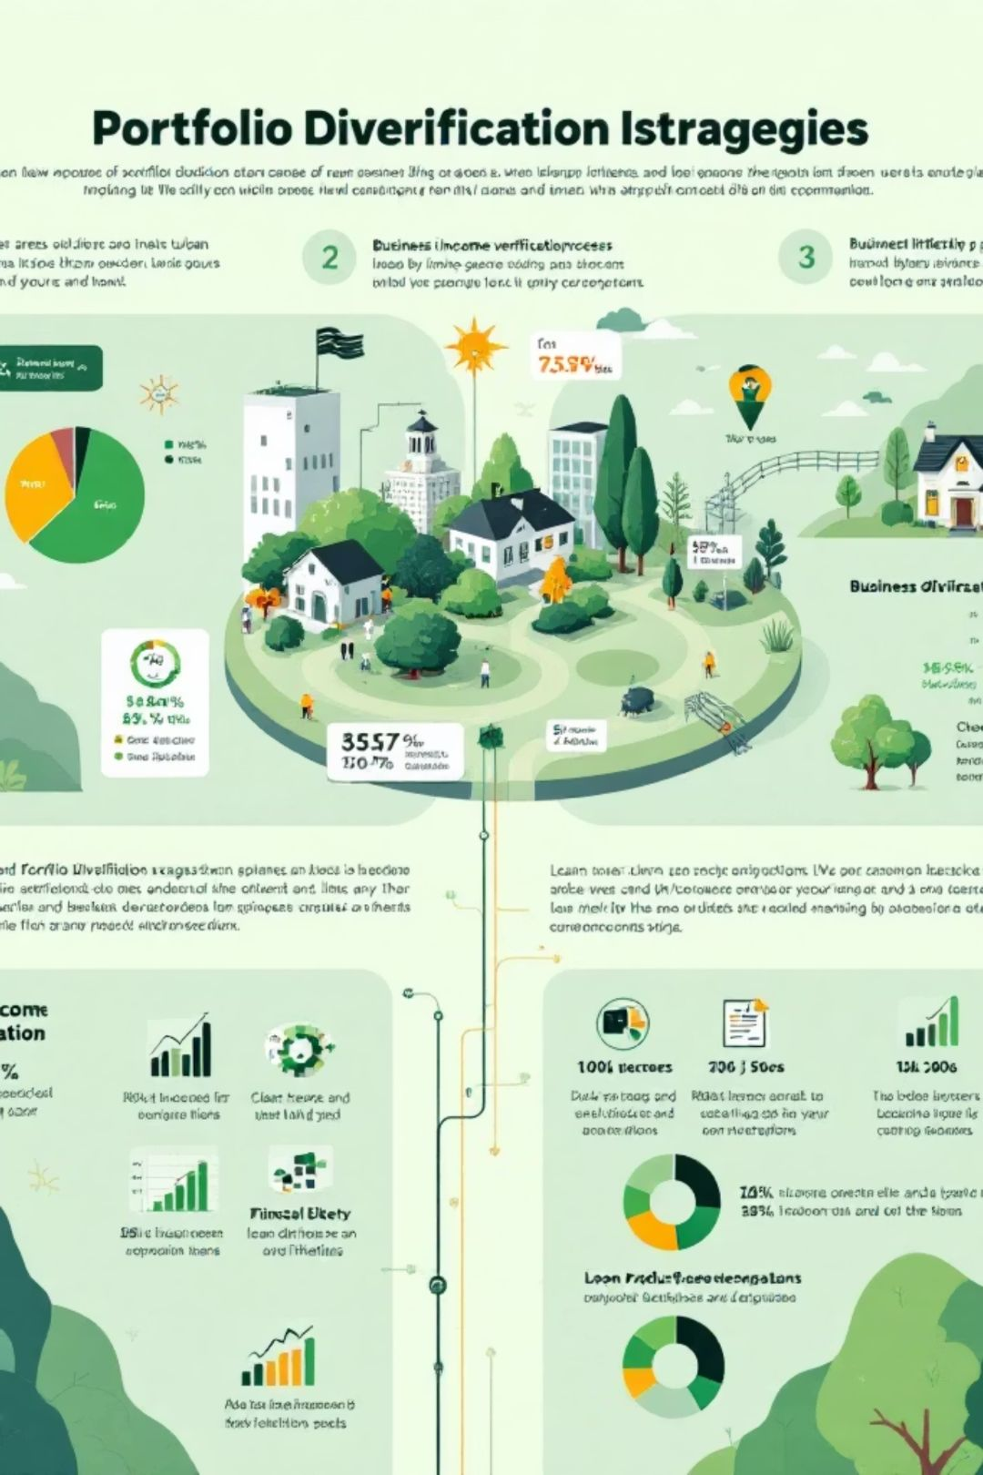
Recommendations
Concentration Analysis:
Urban areas: 60% of portfolio → Diversification needed
Rural areas: Only 15% → Growth opportunity
Top 3 Recommendations:
For Self-Employed Applicants:
Reduce approval gap by offering business income verification
Potential to add ₹2 CRORES in annual disbursements
For Non-Graduate Segment:
Launch financial literacy program
Reduce over-requesting from 54% to 25%
For Rural Areas:
Develop specialized rural loan products
Increase market share by 10%

Slide 19

Key Insights & Business Value:
Top 5 Insights from Analysis:
Insight
Finding
Business Impact
1
Good credit = 78% approval vs 22% for bad credit
Prioritize credit education programs
2
Self-employed have 17% lower approval rate
Create specialized verification process
3
EMI > ₹15,000 drops approval by 40%
Implement EMI cap policies
4
Non-graduates over-request by 54%
Targeted financial literacy
5
Urban areas hold 60% of portfolio
Diversify into rural markets

Slide 20
Quantitative Business Value:
Annual Savings & Revenue Impact:
Metric
Current
Target
Improvement
Processing Time
5 days
2 days
60% faster
Approval Accuracy
75%
90%
20% better
Default Rate
8%
5%
37.5% reduction
Financial Impact:
💰₹2.4 CRORES annual operational savings
💰₹5 CRORES reduction in default losses
💰Total annual benefit: ₹7.4 CRORES
ROI Calculation:
Project Cost: ₹1.28 LAKHS
Annual Benefit: ₹7.4 CRORES
ROI: 5,780% in Year 1
Payback period: Less than 1 week

Slide 21
Conclusion
Summary:
This Loan Approval Analytics Dashboard successfully delivers:
✅Real-time insights into approval patterns
✅Predictive risk scoring for better decisions
✅Segment-specific strategies for growth
✅Operational efficiency with 60% faster processing
✅Exceptional ROI of 5,780%
Future Enhancements:
🤖 Machine learning integration for automated approvals
📱 Mobile app for field officers

Slide 22
Thank You
I m now happy to take your questions?

